Slide 1


Business Problem (Data Set)
Hotel Booking

Slide 2
Data Analysis Project Steps
identify the business problem
identify the data you want to analyze
Explore and Clean the data set
analyze the data to get usefull insights(Find Research question+Hypothises)
present the data in term of reports and dashboard using visualization.

Slide 3
Business Problem.
In recent years, City Hotel and Resort Hotel have seen a high cancellation rates. Each hotel is now dealing with number of issues as a result, Including fewer revenue and less than ideal room use. Consequently, lowering cancellation rates is both hotels’ primary goal in order to increase their efficiency in generating revenue, and for us to offer thorough business advice to address this problem.
The analysis of hotel booking cancellations as well as other factors that have no bearing on their business and yearly revenue generation are the main topics of this report.

Slide 4
Assumptions
No unusual occurrences between 2015 and 2017 will have a substantial impact on the data used.
The information is still current and can be used to analyze the hotel possible plans in efficient manner.
The hotel are not unanticipated negatives to the hotel employing any advise technique.
The hotel ate not currently using any of the suggested solution.
The biggest factor of effecting the earning of the income is booking cancellations.
Cancellations result in vacant rooms for the booked length of time.
Client make hotel reservation in the same year they make cancellations.

Slide 5
Research Questions
What are the variables that affect the hotel reservation cancellation?
How can we make hotel reservations cancellations better?
How will hotel be assisted in making pricing and promotional decisions?

Slide 6
Hypothesis
Cancellation is High Due to High prices.
When there is longer waiting list, customer tend to cancell more frequently.
The majority of client are coming from offline travel agents to make their reservation

Slide 7
Analysis And Findings
The accompany bar graph show that the percentage of reservations that are cancelled and those are not. It’s obvious that there are till a significant number of reservations that has not been canceled . There are till 37% clients who canceled their reservations which has a significant impact on the hotel ‘s earning.

Slide 8
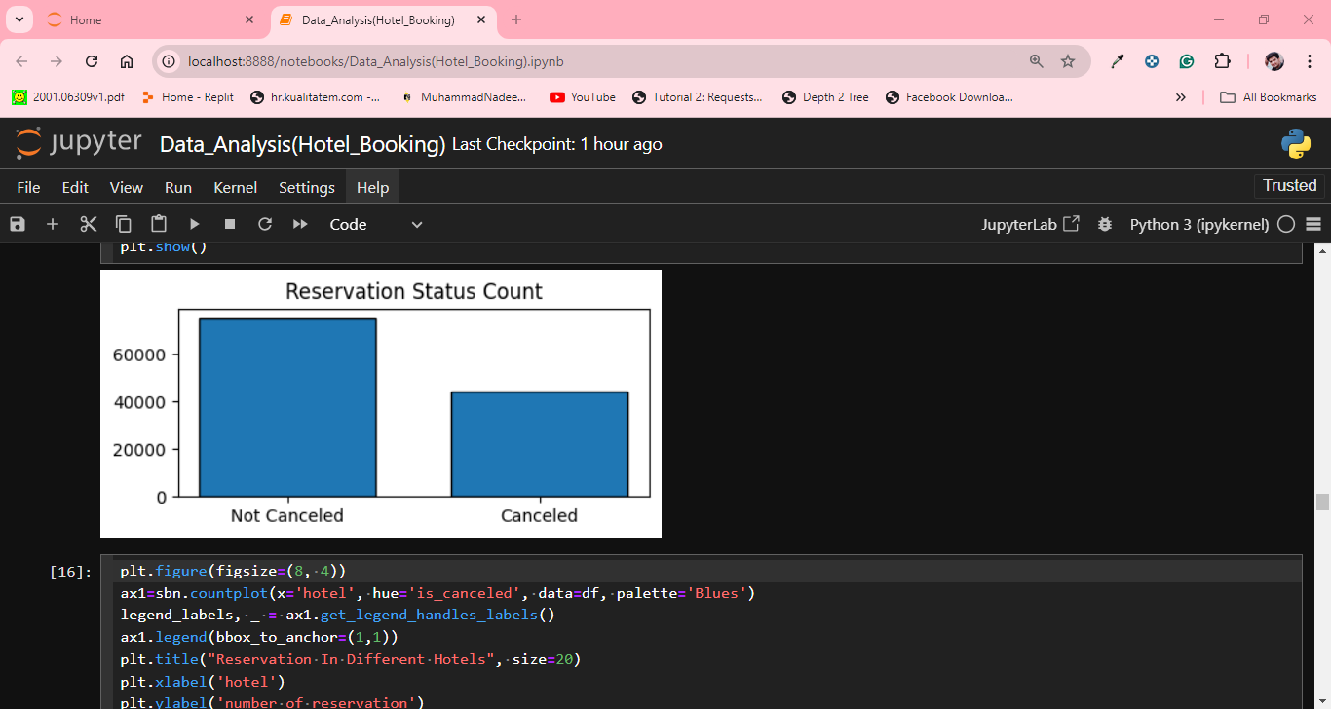
Analysis And Findings

Slide 9
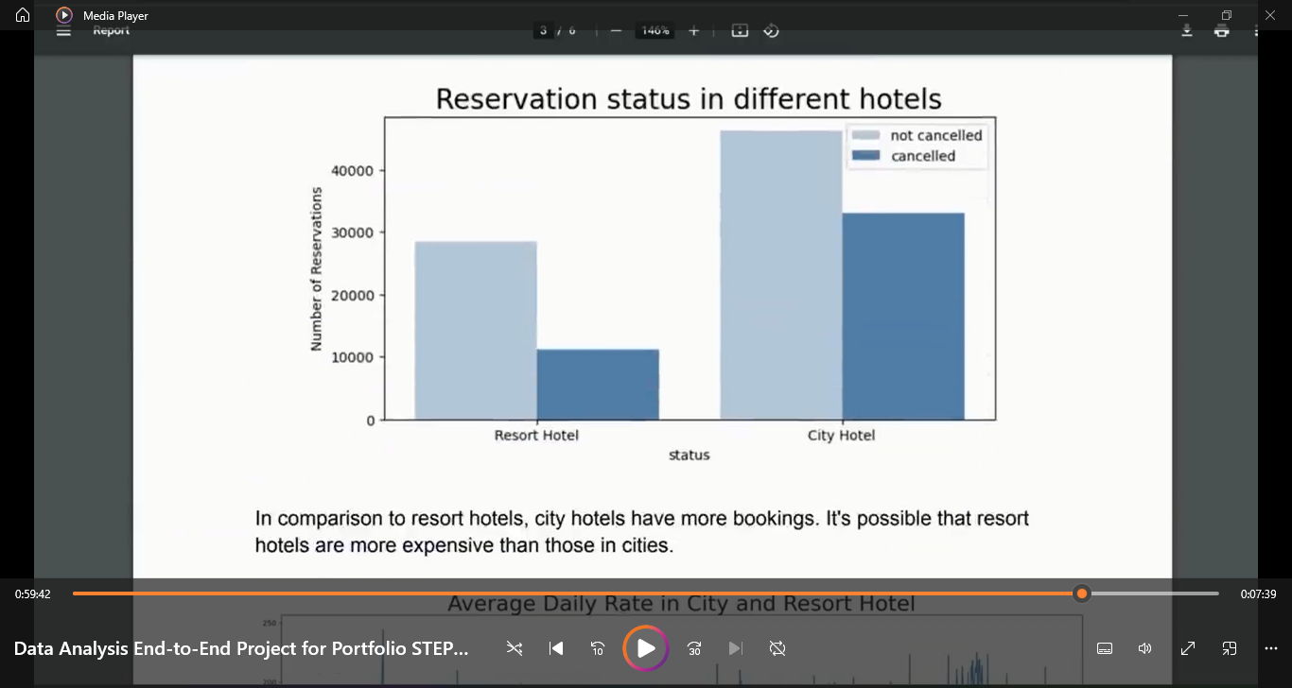
Reservation Status in Different Hotels
In comparison resort hotel, city hotel have more
Booking. It's possible that resort hotel’s are more expensive than city hotels.

Slide 10
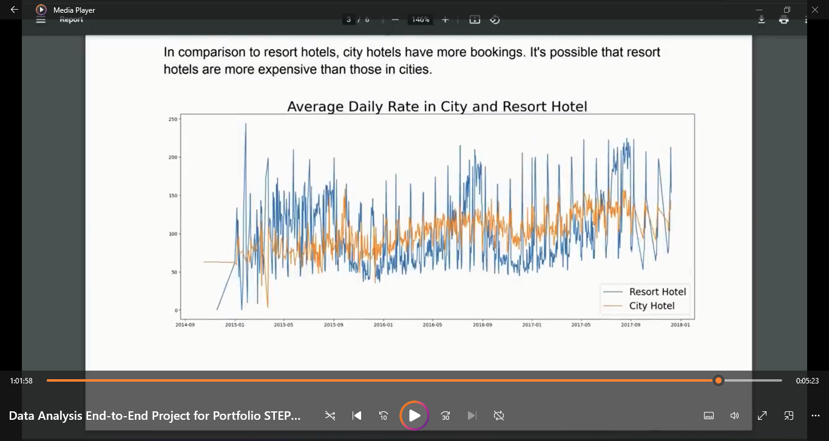
Average Daily Rate in City and Resort Hotel

Slide 11
Average Daily Rate in City and Resort Hotel
The line graph shows that on the certain days the average daily rate in city hotel is less than resort hotel, and on other days , it is even less.. It goes without saying that weekend and holidays rise resort hotel rates.

Slide 12
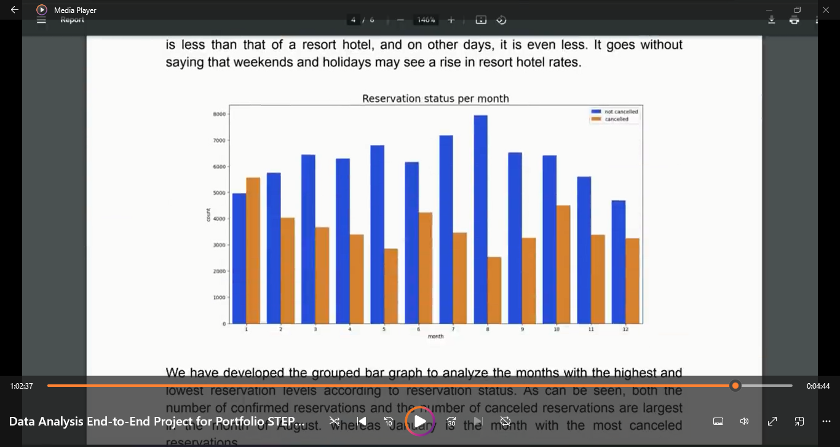
Reservation Status Per Moth

Slide 13
Reservation Status Per Moth
We have developed a grouped bar graph to analyze the reservation with the highest and the lowest reservation level according reservation. As can be seen, both the number of confirmed reservation and number of canceled reservations are the largest in the month of august , whereas January is the month with highest canceled reservation.

Slide 14
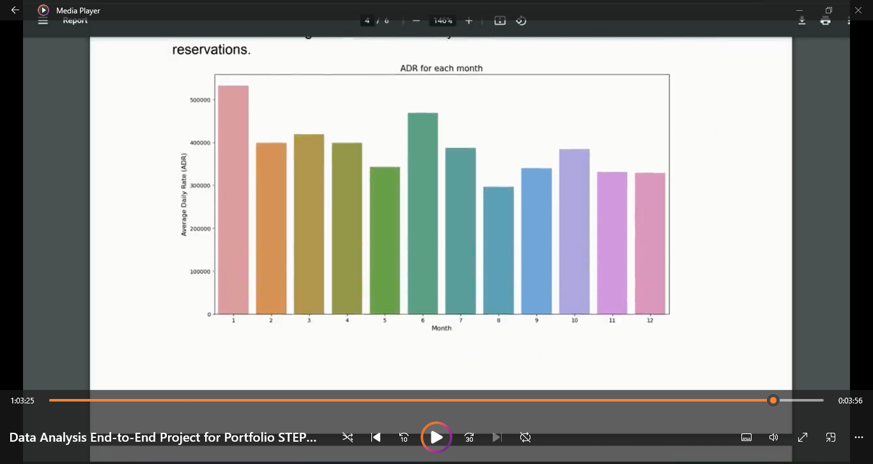
Average Daily Rate For Each Month

Slide 15
Average Daily Rate For Each Month
This graph demonstrate that the cancellation is most highest when the prices are greatest and least common when lowest. Therefore the cost of accommodation is the solely responsible for reservation cancelations.
Now , let’s us see which country is has the highest reservation cancelation. The top is Portugal with the highest number of cancelations.

Slide 16
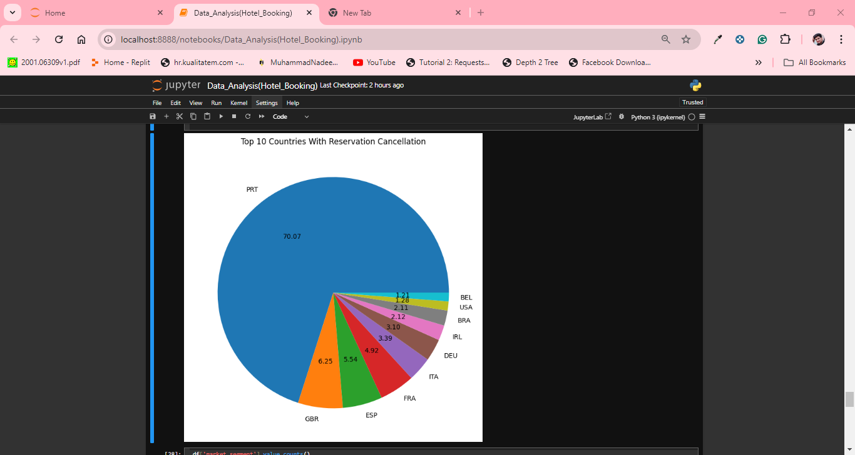
Top 10 Countries With Reservation Cancelation

Slide 17
Top 10 Countries With Reservation Cancelation
Let’s us check the area from where the guest are visiting hotel and make reservations. Is it coming from direct , online or offline travel agent around 46% of the client coming from one travel agencies, where 27% coming from groups. Only 4% client book hotel directly by visiting them and making reservation.

Slide 18
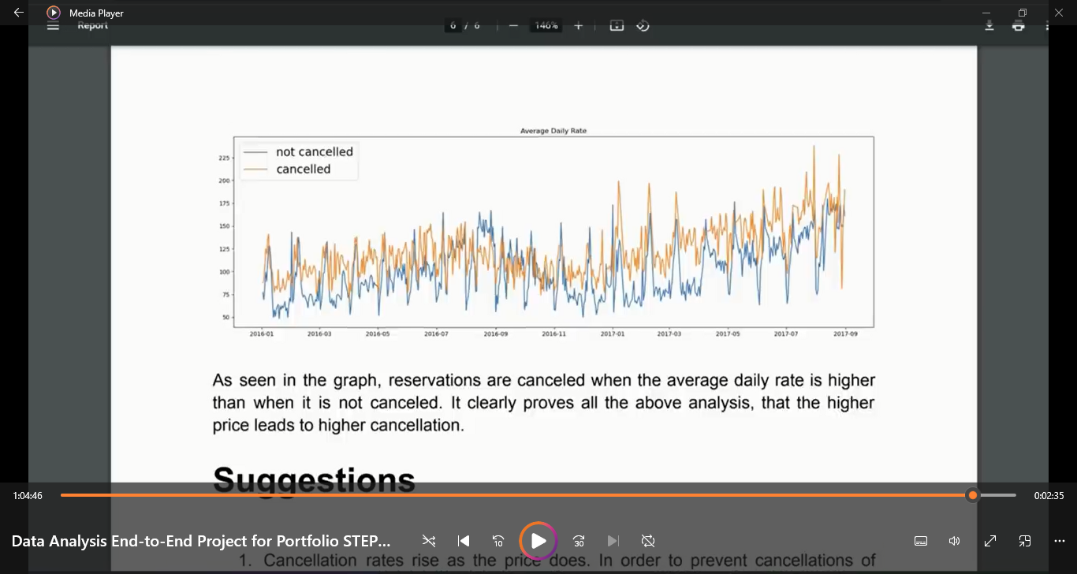
Average Daily Rate
As seen in the graph, reservation are cancelled when the average daily rat is higher than when it is canceled. It clearly proves all the above analysis, that higher the price leads the higher cancelation.

Slide 19
Suggestions
Cancelation rate rise as price does. In order to prevent reservation cancelation, hotels could work on their pricing strategies and try to lower the rates for the specific hotels based on locations . They also provide discount to customers.
As the ratio of cancelation and not cancelation of resort hotel is higher in resort hotel than cities hotels . So the hotel could provide a reasonable discount on the room prices on weekend or holidays.
In the month of January , hotel can start campigns or marketing with a reasonable amount to increase the revenue as cancelation is highest in this month.
They also increase the quality of their hotels and their services mainly in Portugal to reduce cancelation rate.

Slide 20
Thank

